Slide 1
Welcome to Mars. Please don’t die
Running late is our cardio
1835365 - VLAD TURNO
1883008 - GABRIELE INCARBONE
1950722 - DAVIDE TIMPERI
1986026 - FEDERICO MENDIOLA

Slide 2


Slide 3
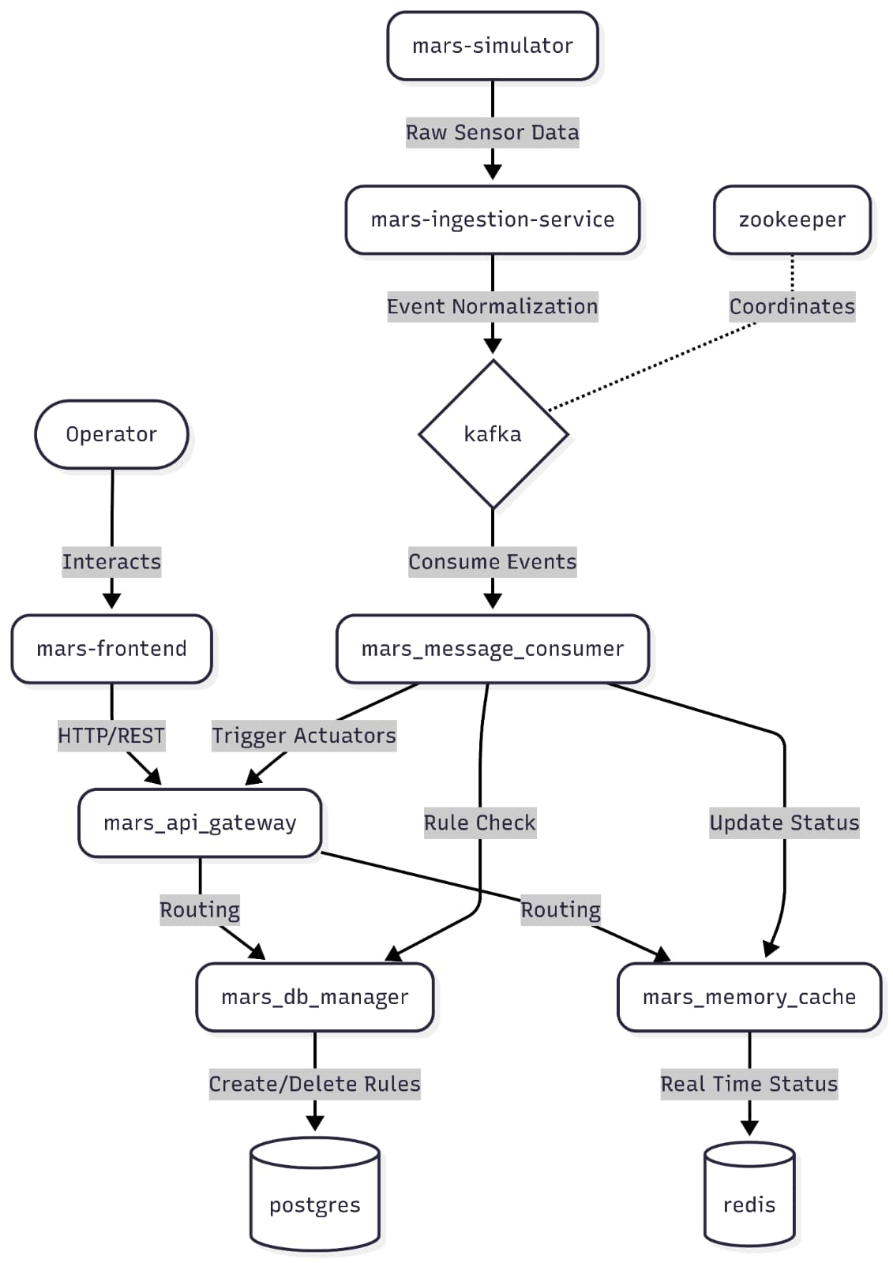
system architecture diagram

Slide 4
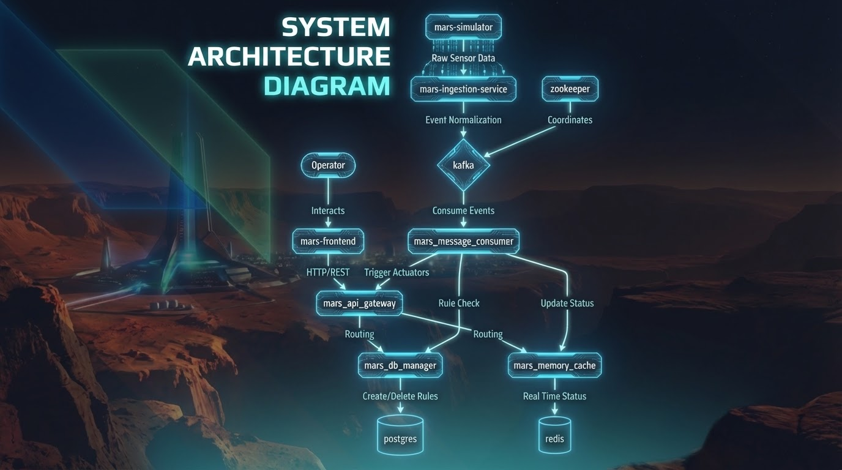

Slide 5
Mars Ingestion Service : Steaming & Polling
Role: Primary bridge between Mars IoT sensors and downstream processing Tech: Spring Boot , Java HTTP Client , Jackson JSON
MarsScheduledIngestionService (API Polling):
@Scheduled HTTP polling every 5 seconds
8 IoT sensors (Temperature, Humidity, CO2, pH, Water Level, Pressure, Air Quality)
Synchronous health checks → sensor polling → JSON mapping → Kafka publish
MarsTelemetryStreamService (Server-Sent Events Streaming):
Approach: Real-time SSE streaming with persistent HTTP connections
7 telemetry streams (Solar Array, Power Bus, Power Consumption, Radiation, Life Support, Thermal Loop, Airlock)
Mechanism: @PostConstruct startup → async stream connections → continuous event reading → real-time Kafka publish

Slide 6
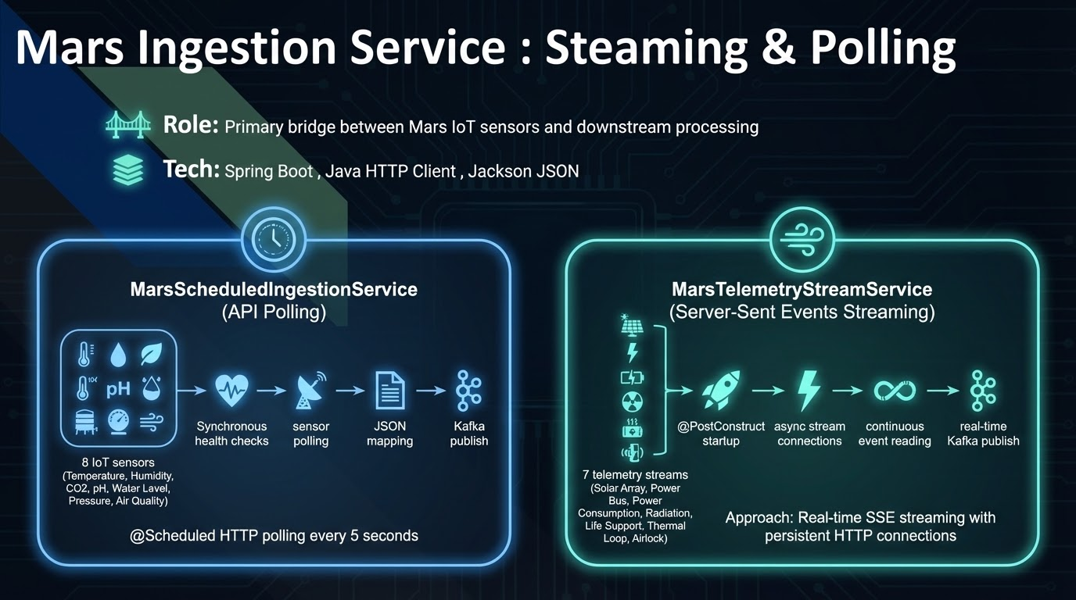

Slide 7
Mars Ingestion Service : Normalization
Role: Transform raw sensor data into a unified event schema Tech: Java + Object mapper
Its fundamental purpose is to solve the heterogeneity problem - we receive data from 10+ different sensor types with varying formats. The Normalizer acts as a universal translator, converting these formats into a single standardized Event schema with consistent fields: timestamp, sensor name, value, unit, and status.
It's intelligent about transformations too - simple scalar sensors map 1:1, but complex sensors like particulate monitors expand into multiple events (PM1, PM2.5, PM10). The chemistry sensor splits into individual metric events, and water level sensors generate both percentage and liter readings.
This normalization layer is what enables downstream services to consume all Mars habitat data through a single, predictable interface.

Slide 8
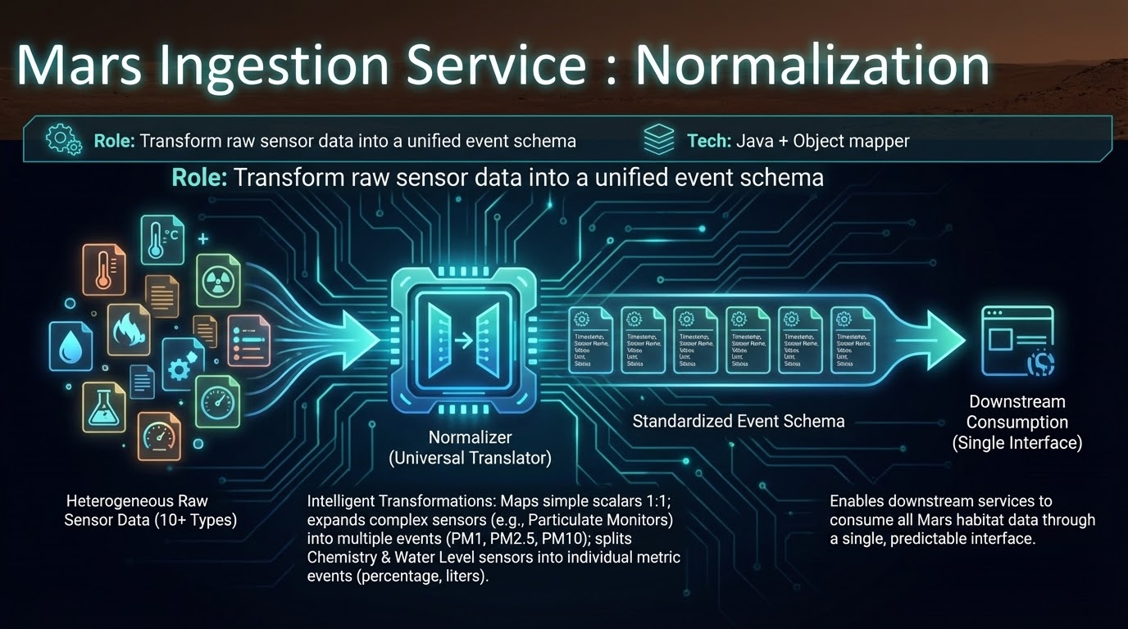

Slide 9
Mars Ingestion Service : Kafka Producer
Role: Publishes normalized Mars telemetry data from the ingestion services to Kafka topics for downstream consumption Tech: CompletableFuture ,Apache Kafka
The now normalized events are now ready to be published into our topic mars-telemetry-events
The events are published asynchronously , this prevents Kafka I/O from blocking the 5-second polling cycles - the ingestion services continue collecting data while Kafka processes messages in the background
We use sensor names as message keys to ensure consistent partitioning - all readings from the same sensor go to the same partition, maintaining chronological order.

Slide 10
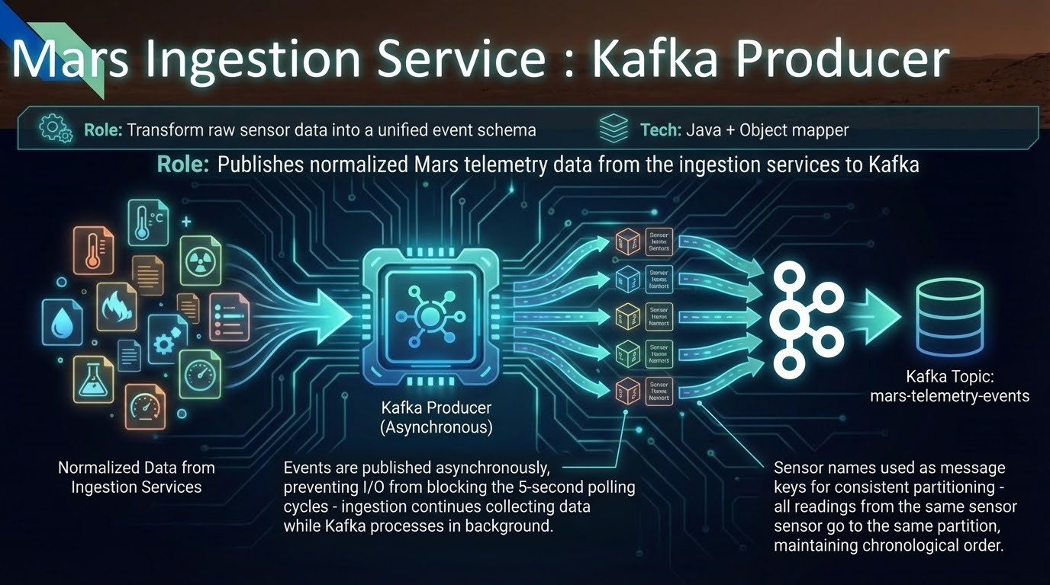

Slide 11
Mars Message Consumer: The Event Processor
Role: The background worker handling high-throughput telemetry data. Tech: Python, confluent-kafka
Listens to the mars-telemetry-events Kafka topic in an infinite loop. Kafka acts as a shock-absorber, preventing system crashes during data spikes.
For every reading, it queries the DB Manager (PostgreSQL) to check if the new value triggers any Automation Rules (e.g., "if temp > 35, turn on fan").
If rules trigger, it commands the API Gateway to physically toggle the actuator. It then saves the new reading to the Cache and tells the Gateway to broadcast it.

Slide 12
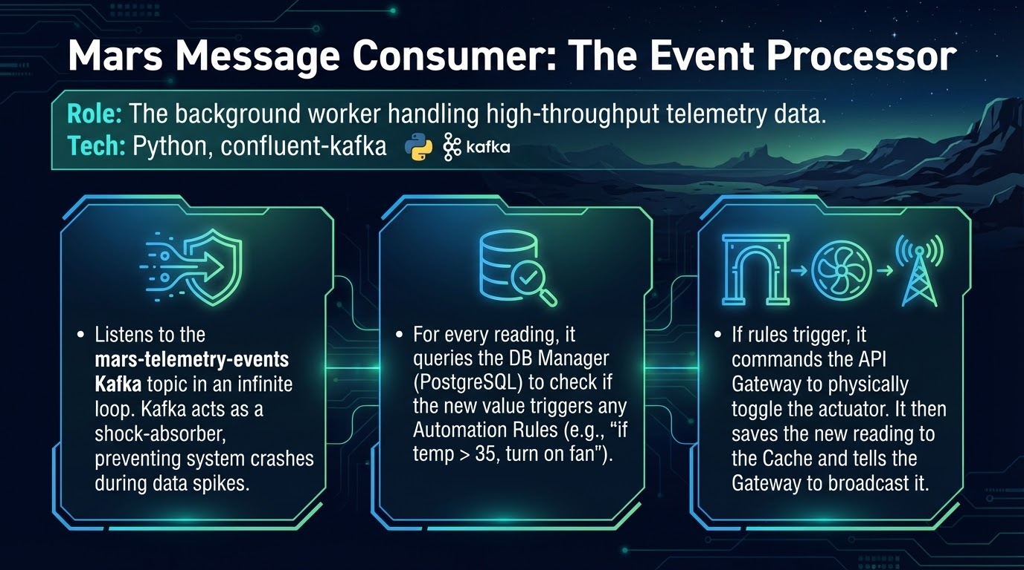

Slide 13
Mars Memory Cache: The Real-Time State
Role: The ultra-fast holder of the facility's current status. Tech: Python, FastAPI, Redis
Redis stores data entirely in RAM. It eliminates slow disk reads when checking the last known value of a sensor.
It only stores the absolute latest state of every sensor. (e.g., it overwrites temp: 22 with temp: 23).
If rules trigger, it commands the API Gateway to physically toggle the actuator. When a user opens the dashboard, the Gateway fetches this entire cache instantly. This makes the UI feel infinitely responsive without hammering a traditional database.

Slide 14
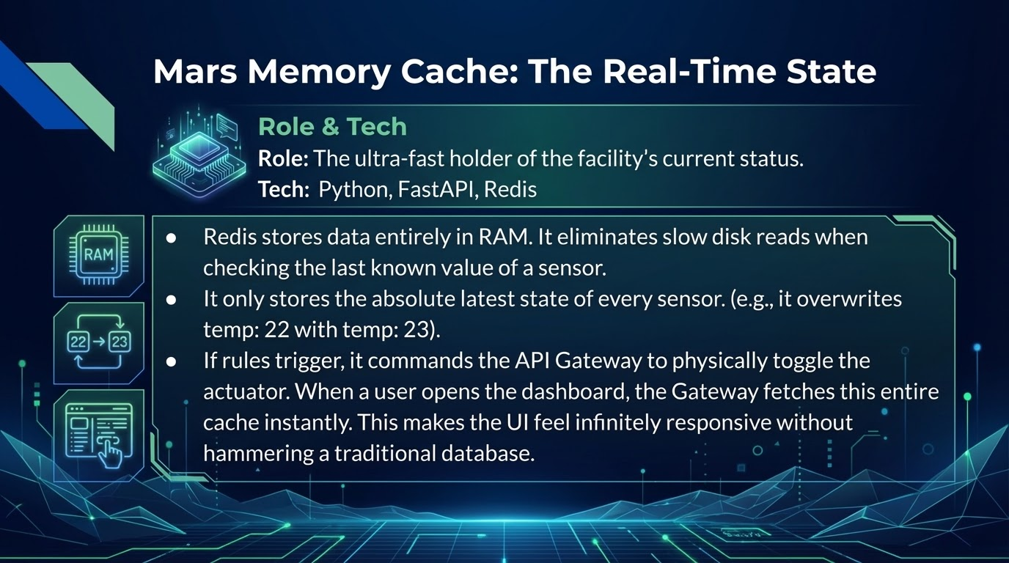

Slide 15
Relational DB implementation with Postgres 15
Rule schema designed to natively map the automation rules expressed by IF-THEN-ELSE conditions
Table: | sensor_name | operator | threshold_value | actuator_device | actuator_state |
Row: |temperature | > | 30 °C | cooling fan | ON |
Dedicated microservice (with Python/FastAPI) to separate database logic from the rest of the system
Secure endpoints exposed for data operations

Slide 16
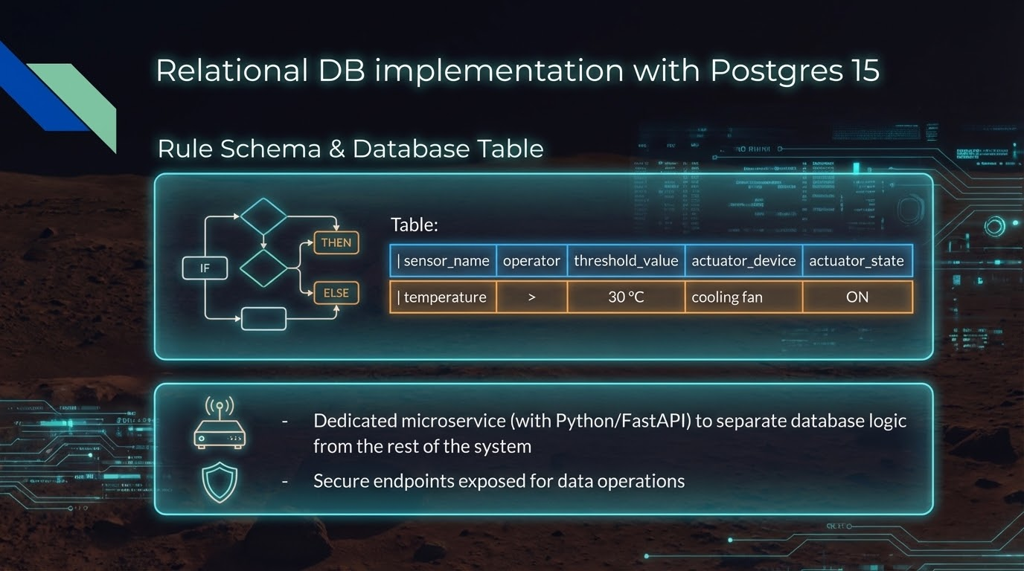

Slide 17
Rule Evaluation & Actuation
Event driven automation engine
Continuous and asynchronous listening to normalized telemetry streams arriving from Kafka
Real time rule evaluation with dynamic db queries
Actuator triggering: When a threshold is breached, the consumer instantly sends an execution command to the API Gateway to change the habitat's parameters.

Slide 18
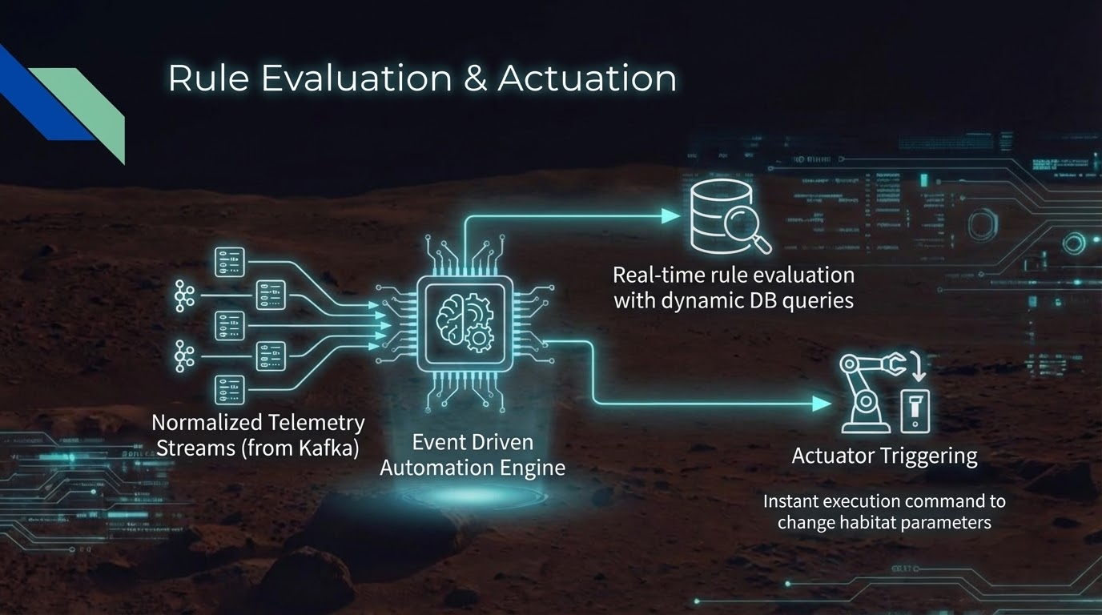

Slide 19
Middleware & API Gateway
mars_api_gateway as the sole middleware routing traffic between the React Dashboard and internal services
Implemented routing functions for creating (POST), reading (GET), and deleting (DELETE) rules
Core services protected: the gateway is the only endpoint exposed!

Slide 20
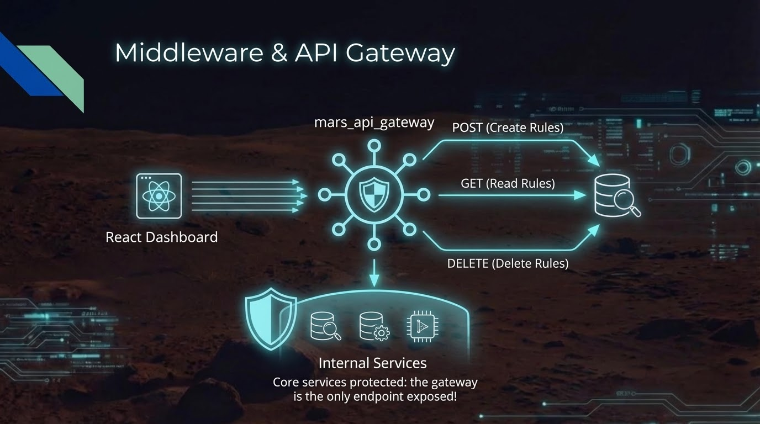

Slide 21
Mars API Gateway: The Frontend BFF
Role: The central hub ("Backend-for-Frontend") connecting React to the microservices. Tech: Python, FastAPI, WebSockets
Consolidates access to the DB, Cache, and Simulator under one localhost:8000 roof, solving difficult browser CORS issues.
Maintains open WebSockets with all active users. When the Consumer broadcasts a new event, the Gateway pushes it instantly to the React app.
Proxies frontend requests (like creating or deleting automation rules) to the isolated DB Manager, enforcing strict separation of concerns.

Slide 22
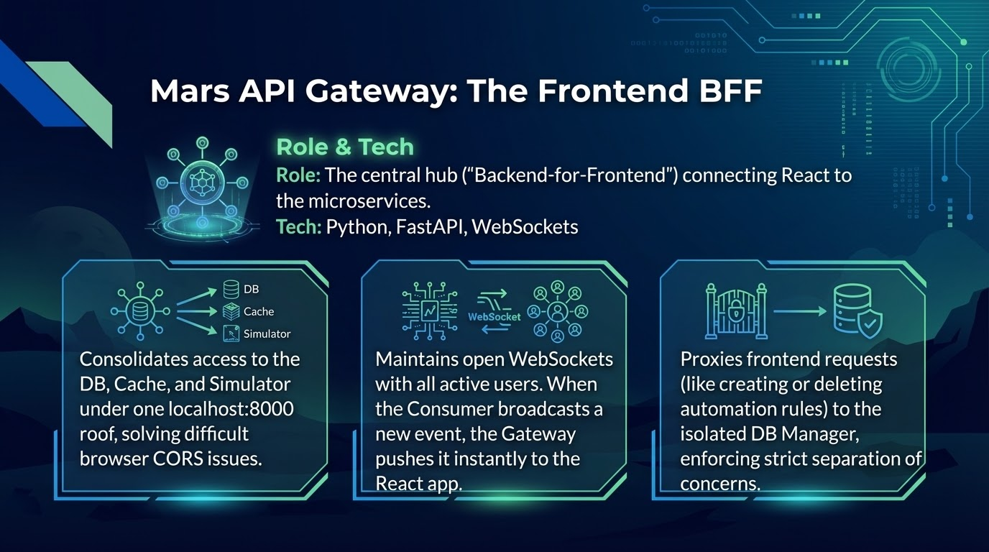

Slide 23
MARS_OS Command Center:
Frontend Architecture
Objective: develop an operational Head-Up Display (HUD) for real-time monitoring and control of the Mars base.
Key Requirements: instant reactivity, zero page reloads (Single Page Application), and complete decoupling from the backend services.

Slide 24
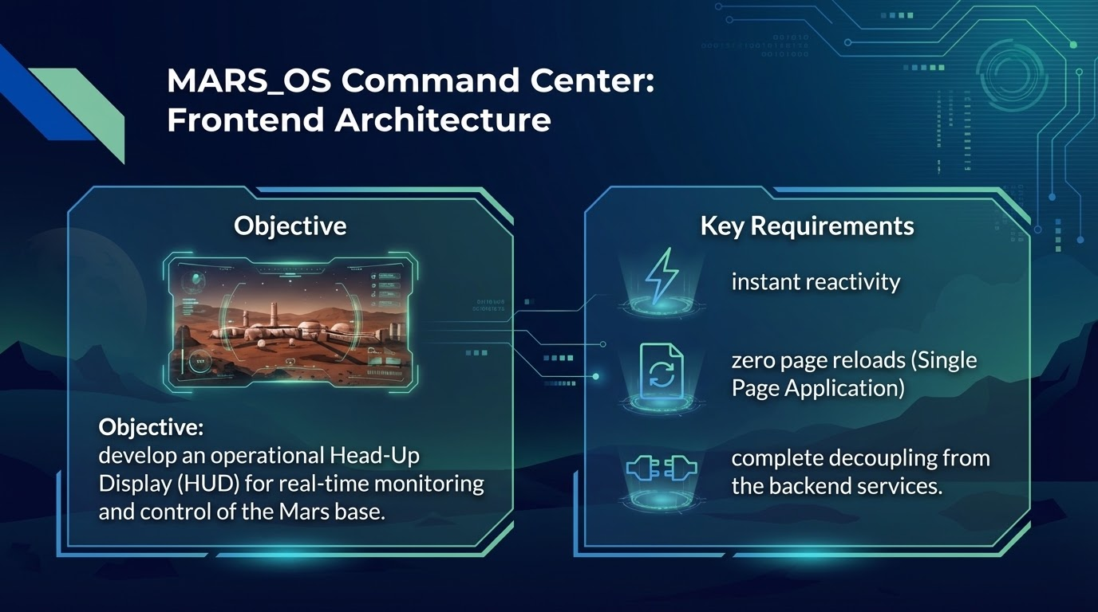

Slide 25
Data Flow: From Sensor to Screen
No Polling, Just Push: leveraging WebSockets for a persistent, bidirectional connection with the API Gateway.
Zero Latency: Kafka-processed events are pushed instantly to the React client.
Dynamic Data Mapping: Runtime formatting function to translate raw sensor paths into clean UI labels, preserving original data integrity for the backend.

Slide 26
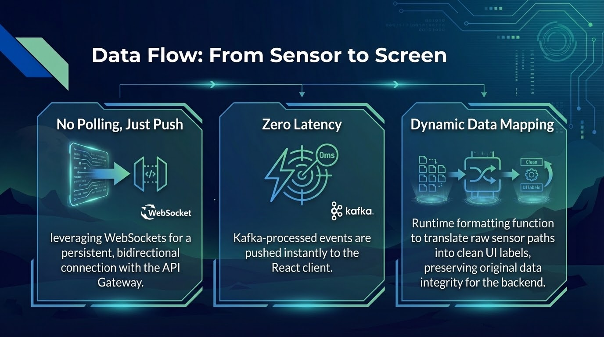

Slide 27
Optimizing User Experience (UX)
Live Historical Charting (Recharts): sliding time window (last 20 samples) for Greenhouse Temperature, updating dynamically on every WebSocket event.
Optimistic UI for Actuators: immediate visual feedback upon operator click.
Asynchronous REST API (POST) execution in the background.
Automatic Rollback mechanism to revert UI state in case of network or server failure.

Slide 28
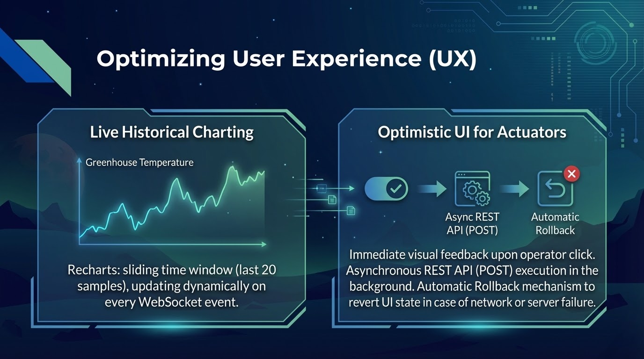

Slide 29
Dynamic Automation Engine
Dynamic UI Components: IF/THEN dropdowns automatically populate by extracting keys from the live application state.
Future-Proof Scalability: New backend sensors are instantly integrated into the rules menu without any frontend code changes.
Full API Integration: Complete rule lifecycle management (Initial Fetch, POST for creation, DELETE for removal) fully synced with the PostgreSQL database.

Slide 30
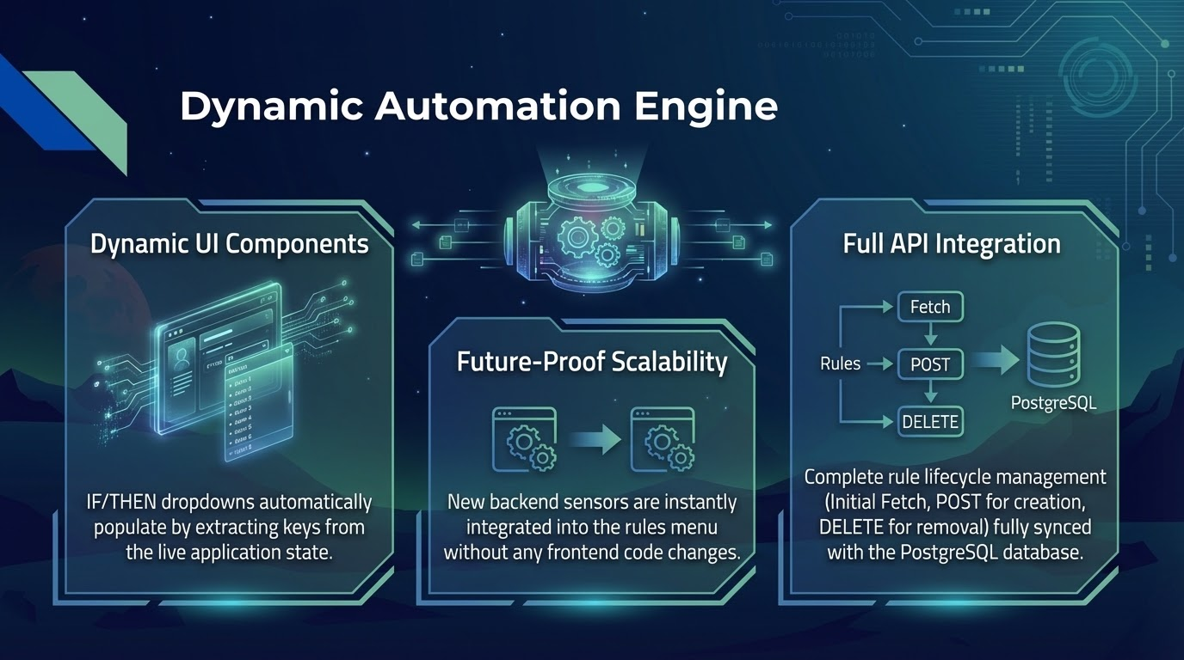

Slide 31
Tech Stack & Deployment
Core: React.js + Vite (for ultra-fast builds and hot-reloading).
Styling: TailwindCSS (Dark/Sci-Fi design system, responsive, utility-first).
Deployment: Containerized via Docker.
Configuration: Environment variables (VITE_API_URL) injected via docker-compose.yml for "Plug & Play" microservices integration.

Slide 32
